Slide 1

Student Management System
PRESENTED BY:
Aishworya Balami
Diksha Thapa
Grishma Bhattrai
Final Project - Fundamentals of Data Science (FODS)
Anusha Tamang

Slide 2

Project Objectives
Data Centralization
Role-Based Access
Performance Tracking
Data Analytics
Provide administrators with automated insights into overall class performance and activity participation.
Store all student-related information, including grades and ECA, in a structured and accessible format using persistent text files.
Provide distinct functionalities for Administrators and Students, ensuring data security and role-specific workflows.
Enable students to monitor their academic progress through visual charts and easy profile management.

Slide 3
Introduction
A Python-based Command Line Interface (CLI) application designed for educational institutions to streamline student data management.

Slide 4

Problems and Solutions
OUR SOLUTION
THE PROBLEM
A centralized digital system to manage
profiles and grades
.
Manual record-keeping is highly
inefficient and slow
.
Automated tracking of
extracurricular activities
.
Data entry is prone to
human error
and inconsistencies.
Built-in
analytics
for performance assessment.
Lack of
real-time insights
and data visualization.

Slide 5

System Architecture
LOGIC LAYER
DATA LAYER
PRESENTATION
Python 3.x
File-Based Storage
Matplotlib
Core programming language used for system logic and CLI implementation.
Uses persistent text files (.txt) for storing user data, grades, and logs.
Library used for generating performance charts and data visualizations.
OOP Pattern
CRUD Operations
Object-Oriented Programming ensures modularity and code reusability.
Standard Create, Read, Update, and Delete logic for file management.
CLI Interface
Command Line Interface for user interaction and system output.

Slide 6

OOP Structure & Class Diagram
USER
STUDENT
ADMIN
ANALYTICS
Base Class
Inherits User
Inherits User
Utility Class
Attributes
Attributes
Attributes
Attributes
- username
- grades
- all_users
- data_source
- password
- eca_records
Methods
Methods
- role
Methods
+ add_user()
+ calc_averages()
Methods
+ view_profile()
+ modify_record()
+ plot_trends()
+ login()
+ update_profile()
+ delete_student()
+ get_top_students()
+ logout()
+ view_grades()

Slide 7

System Workflow
01
02
03
04
05
Authentication
Role Check
Main Menu
Action Execution
Persistence
Users log in with credentials validated against passwords.txt.
System identifies user as Admin or Student to grant access.
Users are presented with role-specific navigation options.
Changes are immediately updated in the respective text files.
Operations like adding data or viewing charts are performed.

Slide 8
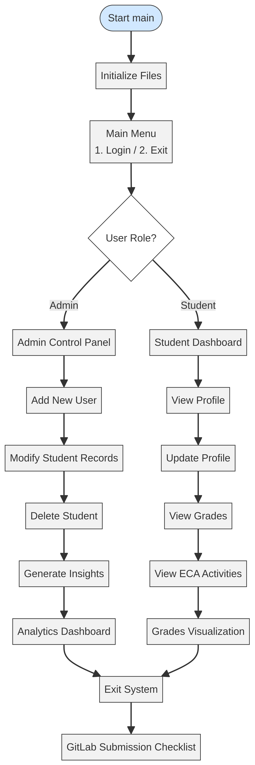
System flowchart

Slide 9

Features: Student Portal
Profile Management
Academic Tracking
Students can view and update core personal details (name, email) so records stay current.
Quick access to current grades and subject performance for easy progress checks.
ECA Monitoring
Performance Visualization
Track participation in extracurricular activities to balance school life.
Generate dynamic bar charts of grades for a quick visual self-assessment.

Slide 10

USER LIFECYCLE MANAGEMENT
Admin Control Panel: Full Oversight
Automated generation of
Unique IDs
(STUxxx / ADMxxx) based on existing records.
Secure registration of new users with role-specific data initialization.
MULTI-FILE CRUD OPERATIONS
Synchronized modification of personal info, grades, and ECA records.
The Administrator role provides complete control over the student lifecycle and system environment.
Complete deletion of student data across
all four system files
to ensure integrity.
SYSTEM MAINTENANCE
Built-in
initialize_files()
logic to set up the data directory and default accounts.
Global oversight via the "View All Students" summary dashboard.
def generate_unique_id(self, role): prefix = 'STU' if role == 'student' else 'ADM' ... return f"{prefix}{count:03d}"

Slide 11
Data Persistence & File Handling
users.txt
passwords.txt
grades.txt
eca.txt
USER PROFILES
AUTHENTICATION
ACADEMIC DATA
ACTIVITIES
Stores general student information, including names, email addresses, and associated user IDs.
Contains login credentials and role assignments (Admin/Student) for secure system access.
Records subject-specific marks for each student, used for performance tracking and charts.
Tracks participation in extracurricular activities to provide a holistic view of student engagement.

Slide 12

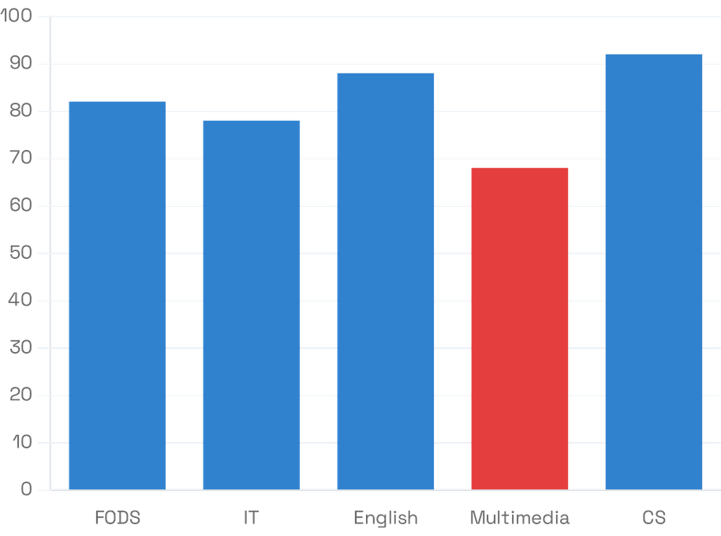
Analytics Dashboard: Data-Driven Proactive Insights
PERFORMANCE ALERTS
Automatically identifies students requiring academic support based on a predefined threshold.
CRITICAL THRESHOLD: < 70%
Flags students for tutoring sessions and parent-teacher meetings.
ECA CORRELATION
Uses Numpy & Matplotlib to analyze the link between extracurricular involvement and academic success.
STATISTICAL SUMMARY
Leverages Pandas to generate class averages and identify top/bottom performers.
Class-Wide Subject Performance Trends

Slide 13

Testing & Quality Assurance
VERIFICATION
ERROR HANDLING
RESULTS
Unit Testing
File I/O Safety
Authentication
Verified individual functions like login() and data retrieval logic for accuracy.
Implemented try-except blocks to prevent crashes during file access or missing data.
100% success rate in validating credentials against passwords.txt.
Data Integrity
Integration
Input Validation
Confirmed that all CRUD operations maintain consistent state across all text files.
Ensured seamless interaction between the CLI and the underlying file storage system.
Robust handling of invalid user inputs and menu navigation errors.

Slide 14

Challenges & Solutions
THE CHALLENGES
OUR SOLUTIONS
Data Consistency
Synchronized Logic
Maintaining synchronized updates across multiple text files (users, grades, passwords) to prevent data corruption.
Implemented a centralized update function that modifies all related files within a single transaction-like block.
File I/O Errors
Robust Error Handling
Handling potential system crashes during concurrent file reading or writing operations.
Utilized try-except blocks and file validation checks to ensure system stability during all I/O operations.

Slide 15
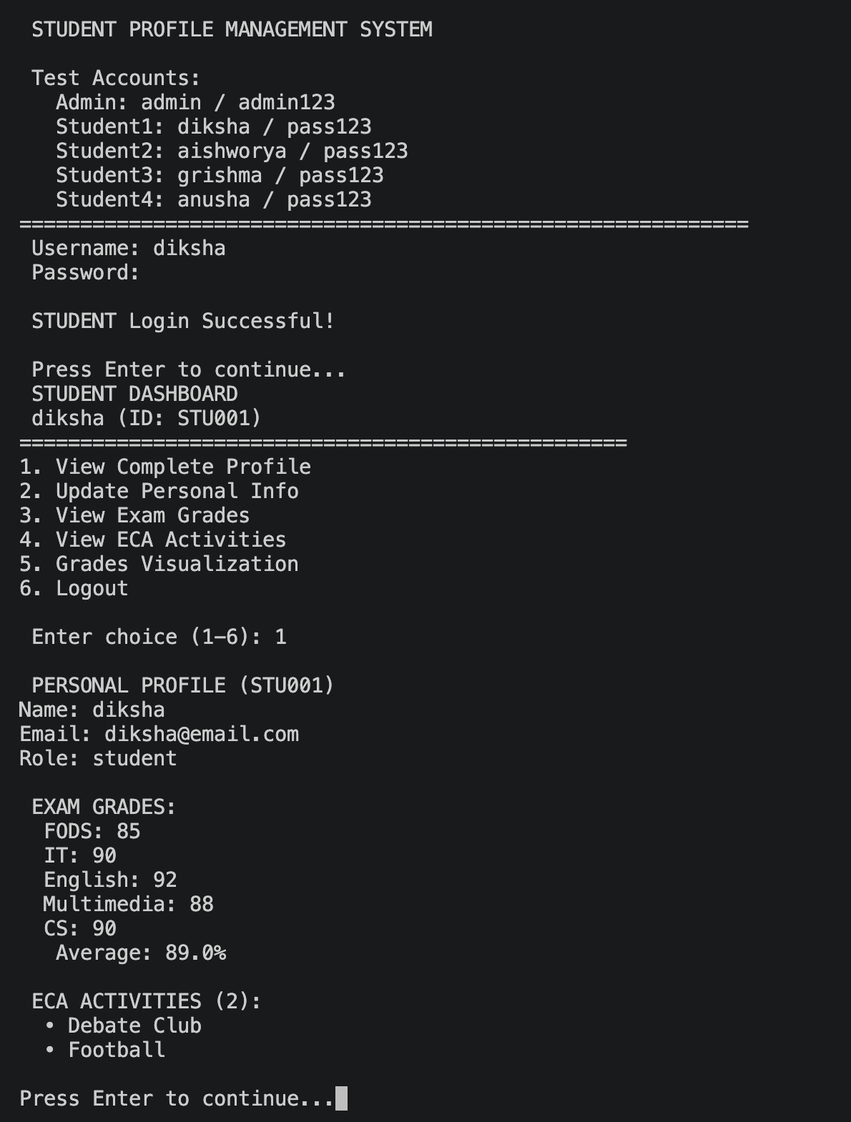
Output

Slide 16
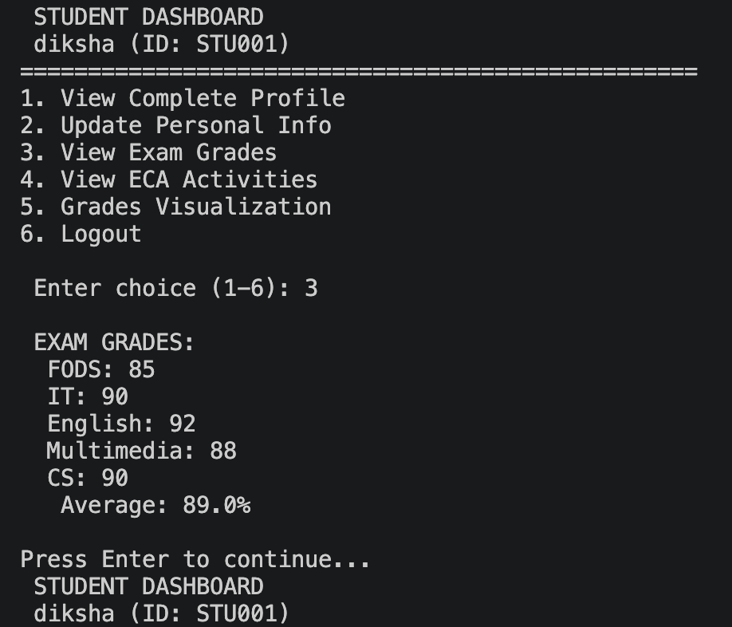
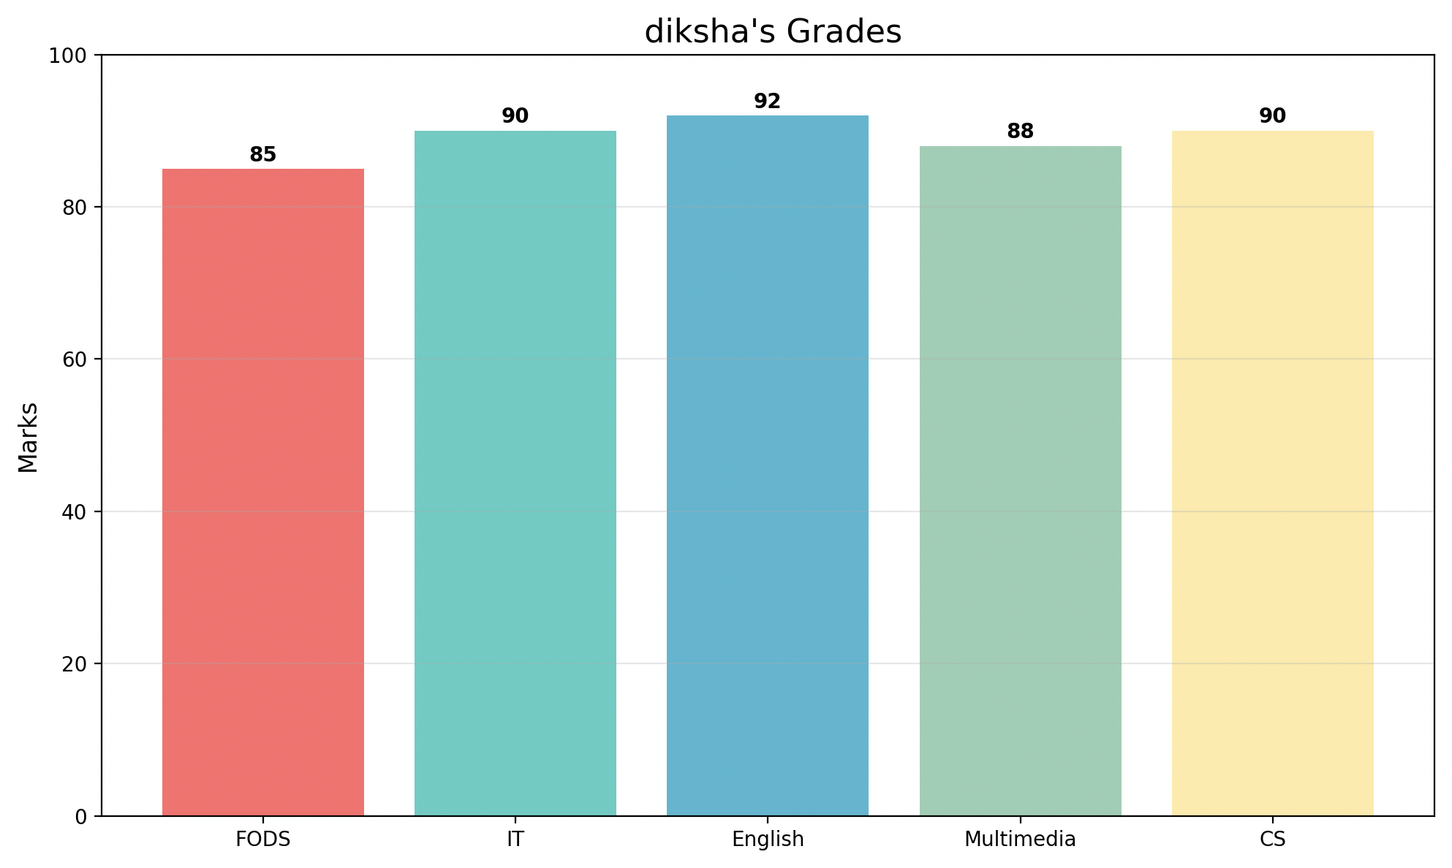
Output

Slide 17
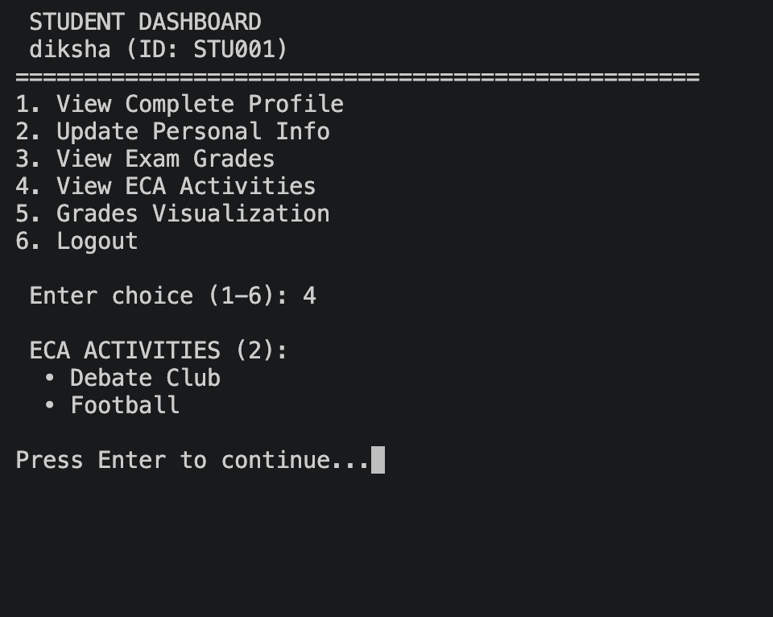
Output

Slide 18
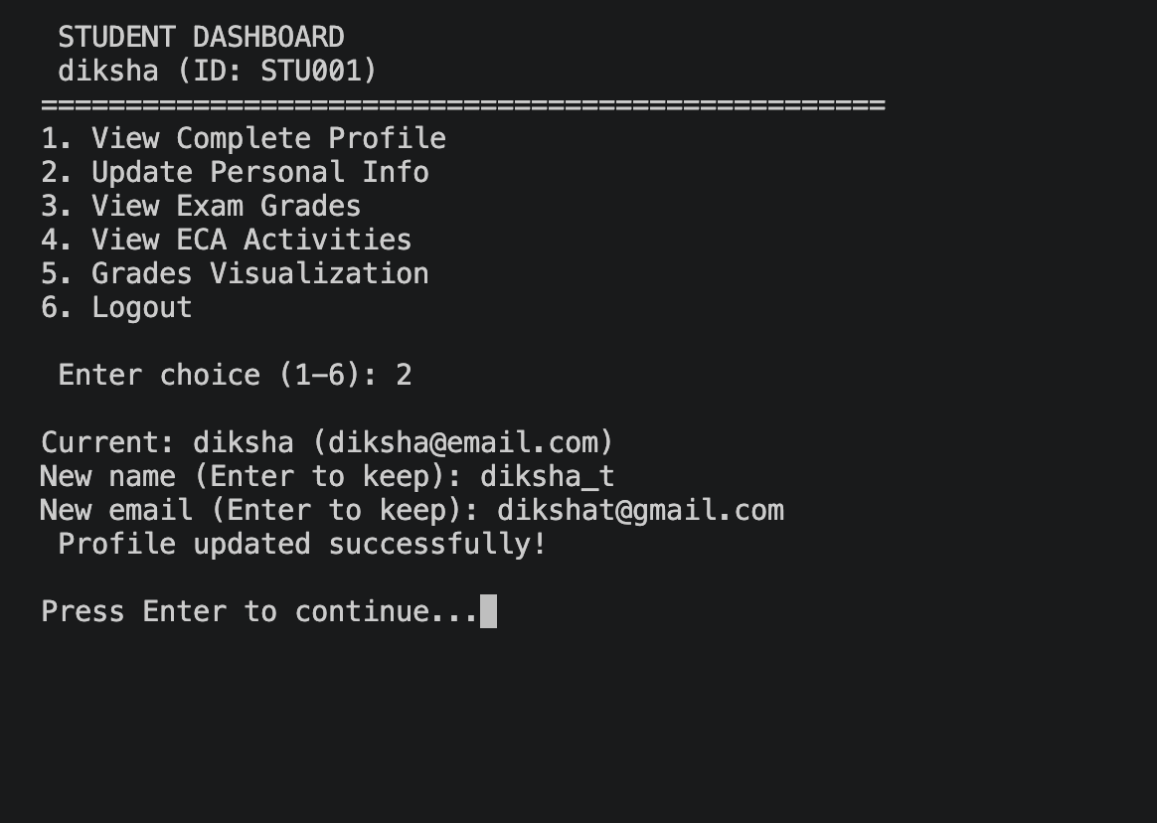
Output

Slide 19
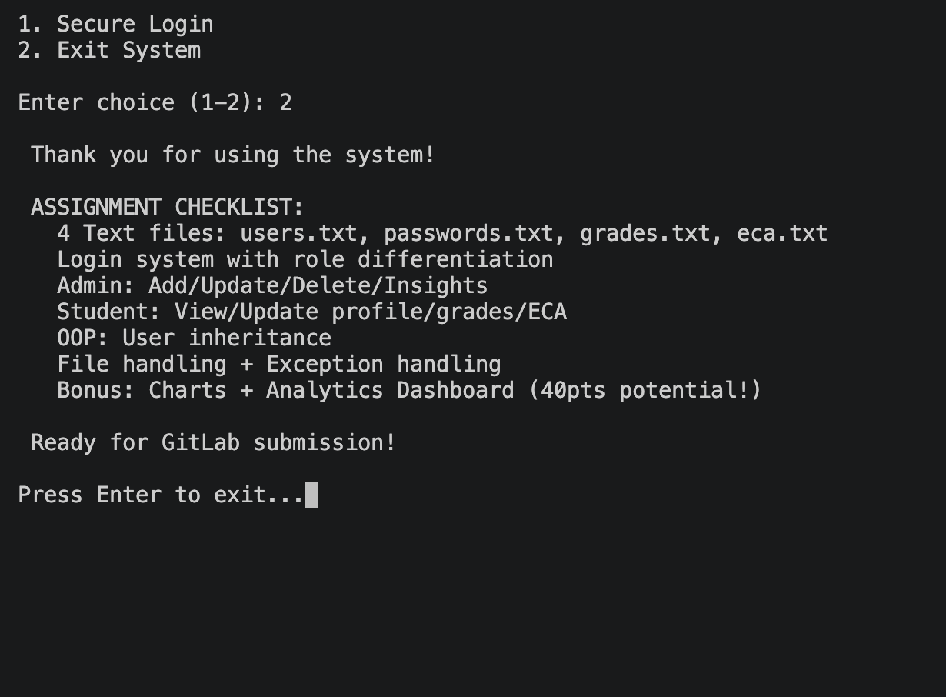
Output

Slide 20
Future Enhancements
Database Integration
GUI Development
Security & Encryption
Web & Mobile Version
Transitioning from text files to a relational database like MySQL or SQLite for better scalability and data integrity.
Developing a user-friendly Graphical User Interface using Tkinter or PyQt to replace the current CLI.
Implementing password hashing (e.g., bcrypt) and secure session management to protect sensitive student data.
Expanding the system to be accessible via web browsers and mobile apps for remote access and real-time updates.

Slide 21
Conclusion
PROJECT SUCCESS
TECHNICAL MASTERY
FUTURE OUTLOOK
Successfully developed a functional Student Management System that meets all core educational requirements for data management and role-based access.
Provided a scalable foundation for future educational tools, with clear pathways for database integration and graphical interface development.
Demonstrated the practical application of OOP principles, persistent file handling, and data visualization using Python and Matplotlib.

Slide 22

Thank You
Q & A
We welcome your questions and feedback regarding our project.
Student Management System

